Slide 1
What’s new in C#8?
Introduction to the new features in C# 8
(and .Net Core 3)
Joseph Reynolds
2019

Slide 2


Please Be Courteous!
Please be courteous to your fellow attendees
and
set your phones to vibrate or silent mode!

Slide 3
What’s new in C#8?
Another year, another Visual Studio (VS2019) and another C# version (C# 8).
How did we reach C# 8?
What’s new in C# 8?
Each of these questions will be answered and the new features will be demonstrated in practical examples.

Slide 4
Visual Studio History and Naming
Visual Studio 7
Visual Studio .NET 2002
C# 1.0
Visual Studio 7.1
Visual Studio .NET 2003
Visual Studio 8
Visual Studio 2005
C# 2.0
Visual Studio 9
Visual Studio 2008
C# 3.0
Visual Studio 10
Visual Studio 2010
C# 4.0
Visual Studio 11
Visual Studio 2012
C# 5.0
Visual Studio 12
Visual Studio 2013
Visual Studio 14
Visual Studio 2015
C# 6.0
Visual Studio 15
Visual Studio 2017
C# 7.0
Visual Studio 16
Visual Studio 2019
C# 8.0

Slide 5
History in Review C# 1-5
C# 1.0 VS 2002
C# 4.0 VS 2010
Async Features
C# 2.0 VS 2005
C# 3.0 VS 2005
C# 5.0 VS 2012
Caller Information
Dynamic (late) Binding
Generic Variance
Embedded Interop Types
Anonymous Types
Extension Methods
Query Methods
Lambda Expressions
Expression Trees
Partial Methods
Partial Types
Anonymous Methods
Iterators
Nullable Types
Private Setters
Delegates
Variance
Static Classes
Basic Features
Generics
Implicit Variable
Object Initializer
Auto Properties
Named\optional parameters

Slide 6
History in Review C# 6 IN vs2015
String Interpolation
Auto Property Features
Expression Bodied Members
Null Conditional Operators
nameof() operator
Extension Add Methods in Collection Initializers
Using Static
Exception Filter
await in catch\finally block
The Elvis operator – one of the coolest enhancements ever
Nice for one-line methods and properties
Why did it take so long to figure get this one?
Some call this Razor context; I call it fabulous
Notes:
String Interpolation
For example: $”Page {page.number} of {Page.count}”
Auto Property Features
For example: public string MyProperty { get; set; }
Null Conditional Operators
For example: anObject?.aProperty ?? defaultValue
Expression Bodied Members
nameof() operator
Extension Add Methods in Collection Initializers
Using Static
Exception Filter
await in catch\finally block

Slide 7
New Features in C# 7
C# 7.0 VS2017 v15.2
Binary Literals
Digit Separators
Local Functions
Out Variables
Tuples (enhancement)
Deconstruction
Discards
Ref Returns & Locals
Pattern Matching
Expression Bodied Members
Throw Expression
C# 7.1 VS2017 v15.3
Language version selection
Async main
Default literal expressions
Inferred tuple element names
Reference assembly generation
C# 7.2 VS2017 v15.5
Techniques for writing safe code
Reference semantics with value types
Non-trailing named arguments
Leading underscores in numeric literals
private protected access modifier
Conditional ref expressions
C# 7.3 VS2017 v15.7
Theme of better performance for safe code
Reassign ref
Generic constraints
etc
Other enhancements
Testing tuples
Expression variables
Backing fields
etc
VS 2017 v15.3 August 2017
VS 2017 v15.5 January 2018
VS 2017 v15.7 May 2018
Notes:
There are blogs indicasting a version 7.3 is looming

Slide 8
New Features in C# 8
C# 8.0 Preview 1
Non-Nullable & Nullable Reference Types
Async Streams
Indices and Ranges
C# Preview 2
Pattern Matching Enhancements
Using Declarations
Static Local Functions
Disposable ref structs
C# 8 …
New Lightweight Classes: Records
Solving Object Equality with Records
Default Interface Implementations
Improved Extension Support
Async Disposable
https://docs.microsoft.com/en-us/dotnet/csharp/whats-new/csharp-8
Notes:
There are blogs indicasting a version 7.3 is looming

Slide 9
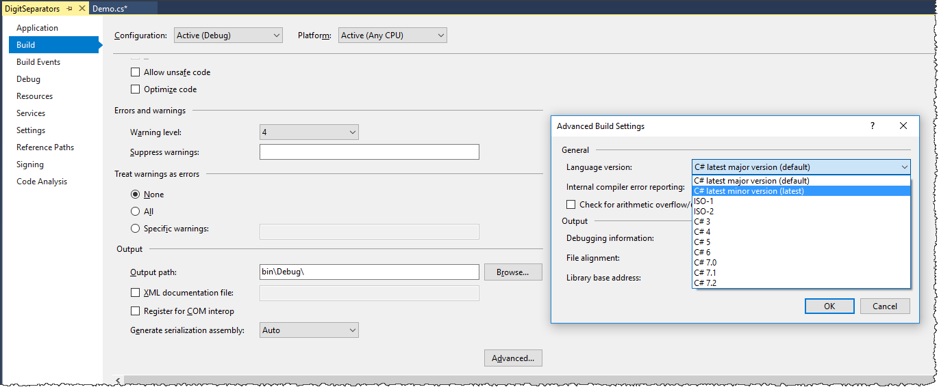
Making v minor versions active
Notes:
This is what they should use as a default

Slide 10
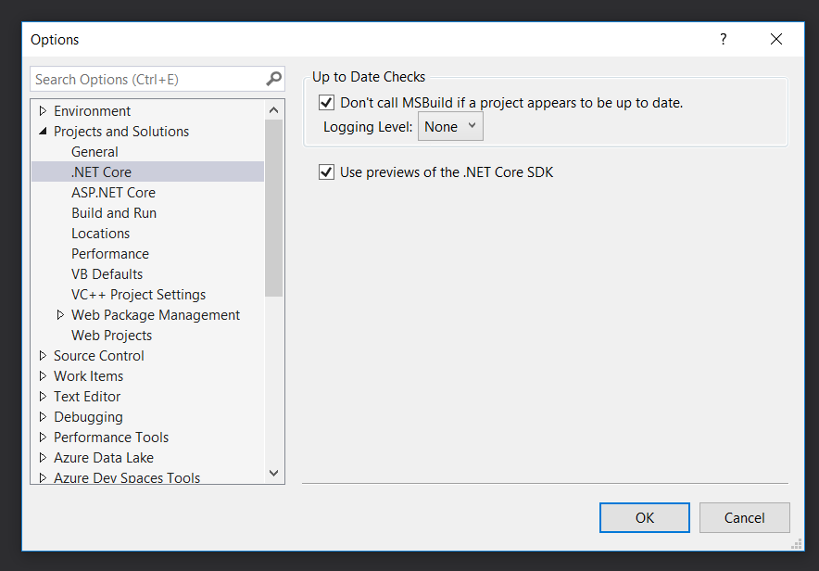

Slide 11
Nullable Reference Types

Slide 12
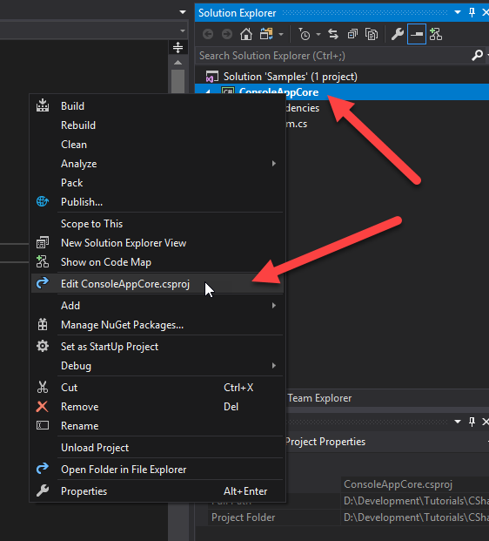

Slide 13
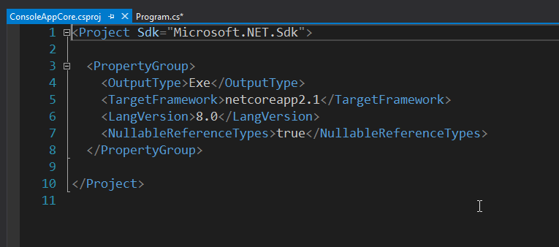

Slide 14
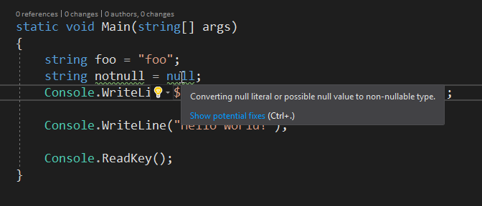

Slide 15
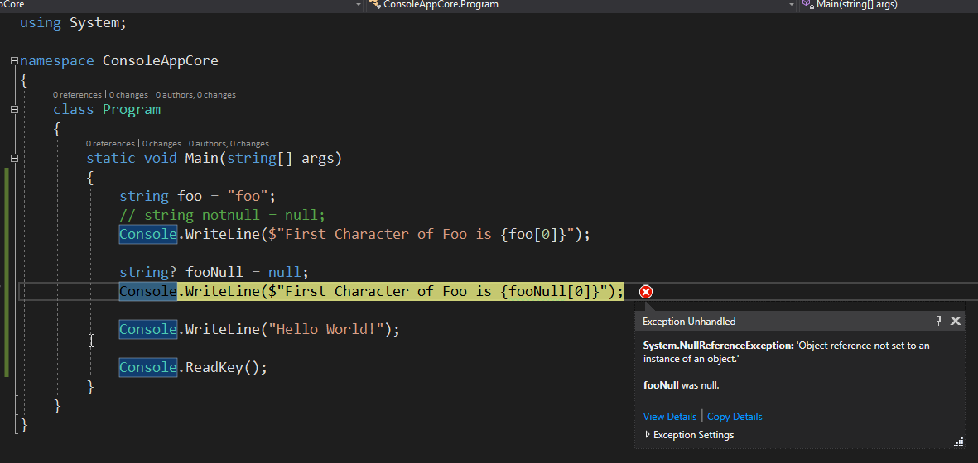

Slide 16
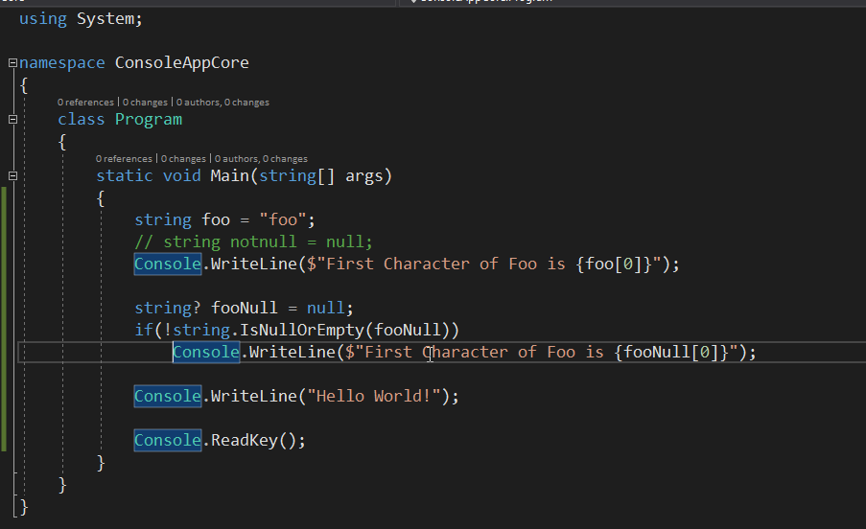

Slide 17
Indices and Ranges
https://docs.microsoft.com/en-us/dotnet/csharp/whats-new/csharp-8#indices-and-ranges

Slide 18
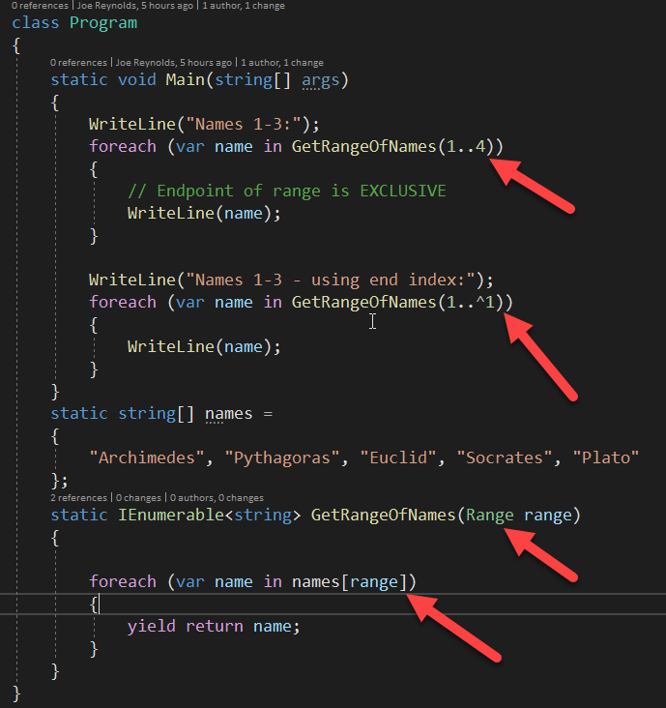

Slide 19
Async IEnumerable

Slide 20
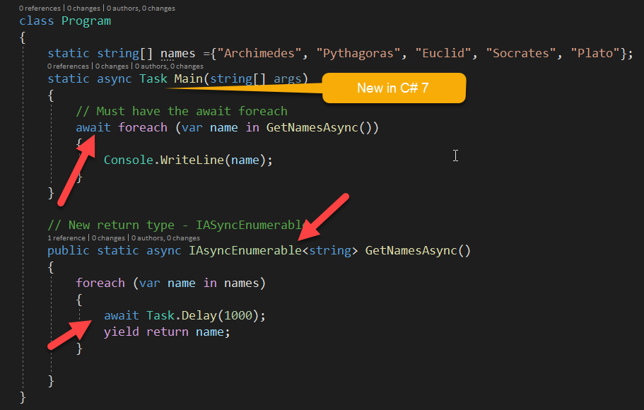

Slide 21
Pattern Matching

Slide 22
C# 8.0 expands this vocabulary so you can use more pattern expressions in more places in your code.
Adds Recursive Patterns
Consider these features when your data and functionality are separate.
Consider pattern matching when your algorithms depend on a fact other than the runtime type of an object.
These techniques provide another way to express designs

Slide 23
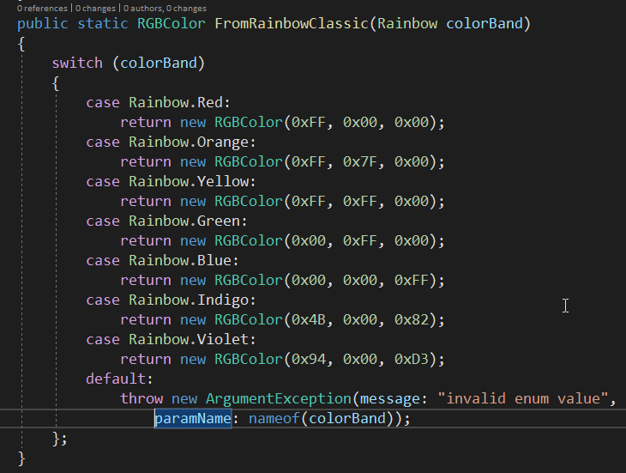
Classic Switch

Slide 24
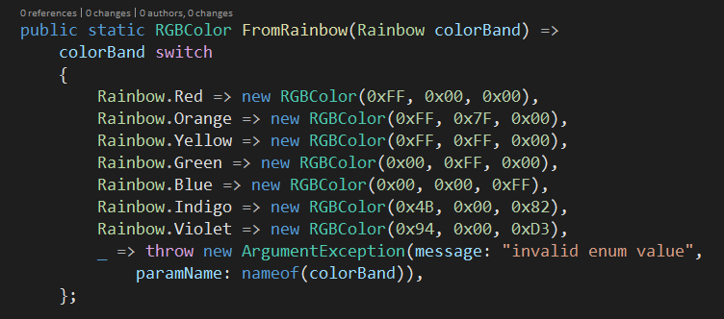
New Switch

Slide 25
The variable comes before the switch keyword. The different order makes it visually easy to distinguish the switch expression from the switch statement.
The case and : elements are replaced with =>. It's more concise and intuitive.
The default case is replaced with a _ discard.
The bodies are expressions, not statements.

Slide 26
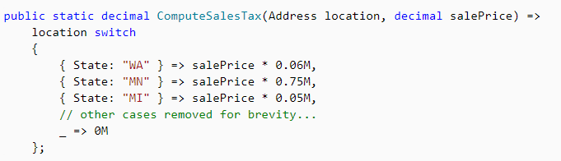
Property Patterns
The property pattern enables you to match on properties of the object examined.

Slide 27
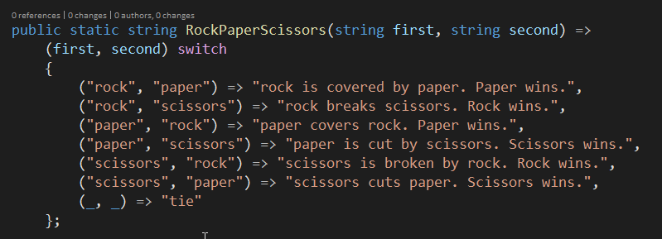
Tuple Patterns

Slide 28
Static Local Functions

Slide 29
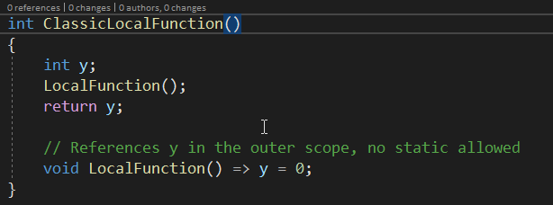

Slide 30
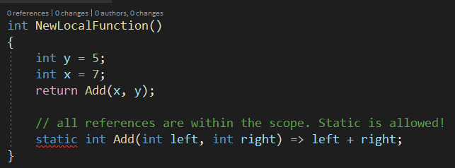

Slide 31
Coming in .Net Core 3

Slide 32
Windows Desktop
WPF
Windows Forms
Entity Framework 6
Release (as of this writing) September 2019

Slide 33
JSON
New built-in JSON reader
Coming Soon:
JSON Writer
POCO serializer
POCO deserializer

Slide 34
.Net 5

Slide 35
Coming in .Net 5
No more .Net Framework – 4.8 is last update
.Net Core will include:
Windows Desktop Development
Cross-Platform development
Mobile Development
Goodbye to:
.Net Standard
.Net Framework
WCF, Windows Workflow
One .Net moving forward

Slide 36
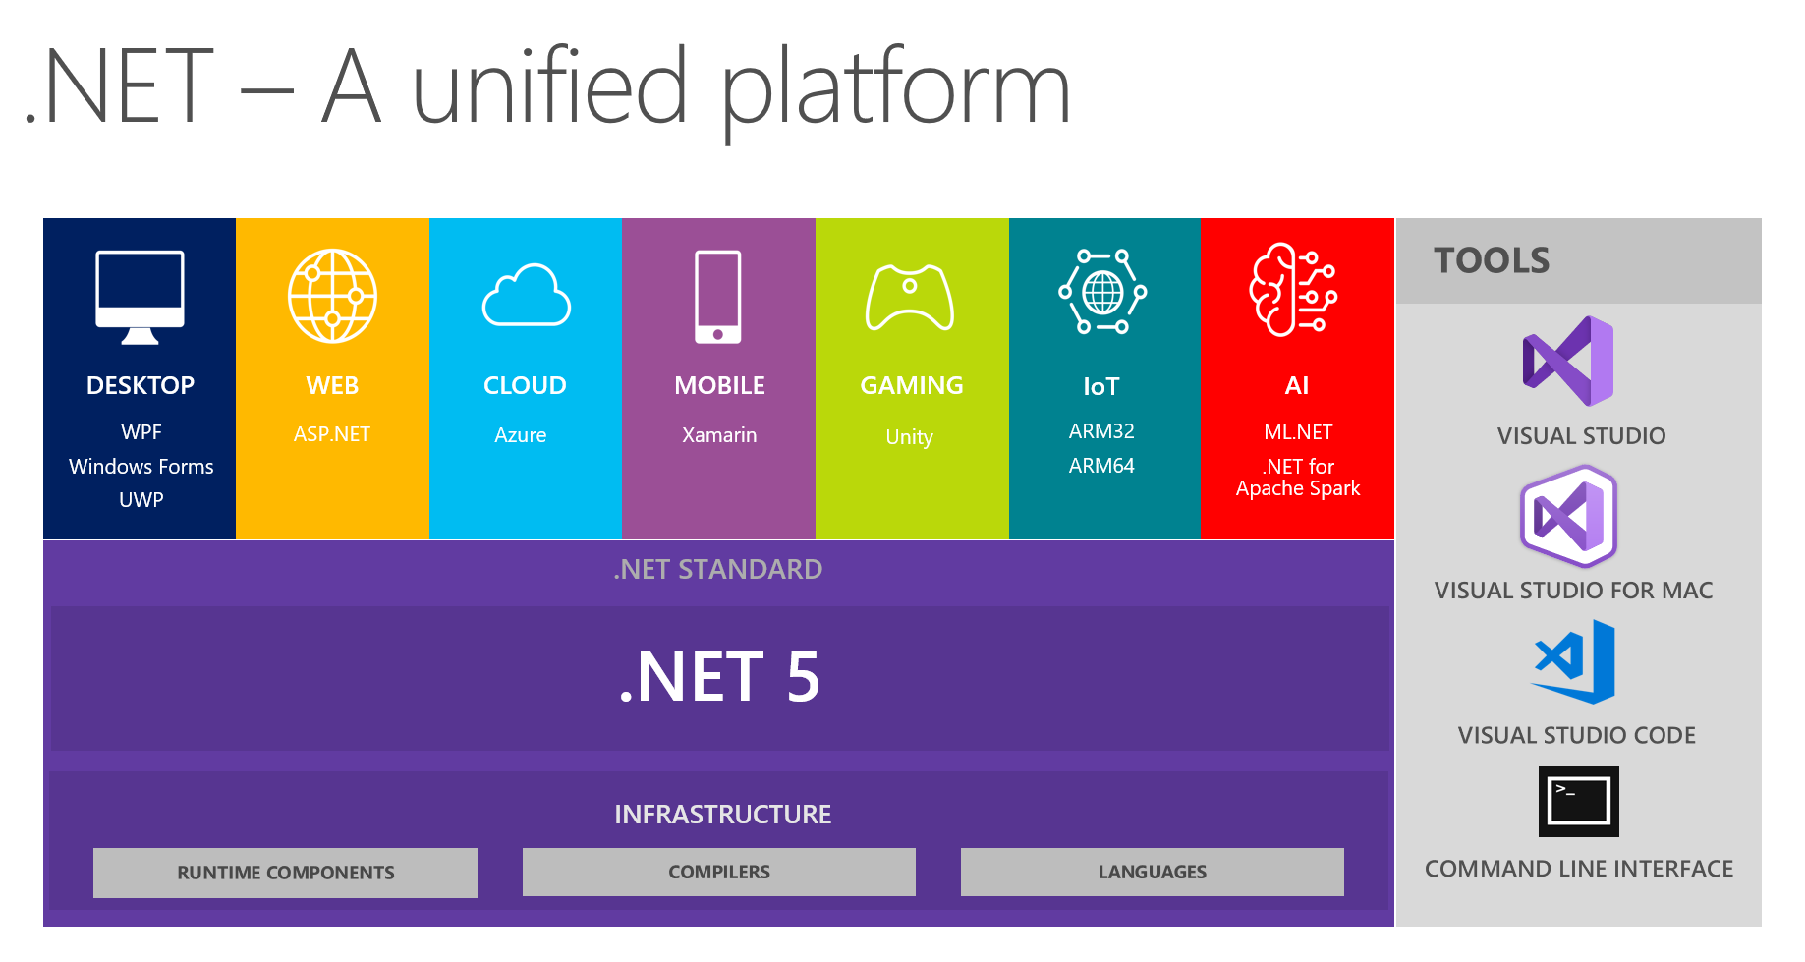

Slide 37
Joseph Reynolds
EMAIL: jreynolds@likeabosscoding.com
Blog: http://www.infocraft.net
Github: https://github.com/jmreynolds
LinkedIn: https://www.linkedin.com/in/josephreynolds/

